Slide 2
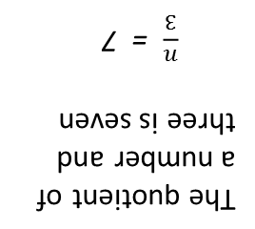
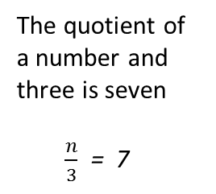
Solving Equations
Three less than a number is twenty
n - 3 = 20
Three less a number is twenty
3 - n = 20
The quotient of a number and three is seven
$\frac{n}{3}$ = 7
Four times a number is twenty
4n = 20
Seven plus a number is twenty
7 + n = 20
Times
Product
Multiplied
Each
Of
Double/Triple
Minus
Difference
Less Than
Subtract
Decreased By
Less
Plus
Sum
More Than
Total
In All
Teacher Notes
Divide
Quotient
Solving Equations
Seven plus a number is twenty
7 + n = 20
Three less than a number is twenty
n - 3 = 20
Three less a number is twenty
3 - n = 20
Four times a number is twenty
4n = 20
Teacher Notes
The quotient of a number and three is seven
$\frac{n}{3}$ = 7
Plus
Sum
More Than
Total
In All
Minus
Difference
Less Than
Subtract
Decreased By
Less
Times
Product
Multiplied
Each
Of
Double/Triple
Divide
Quotient

