Slide 1
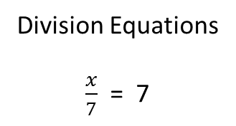
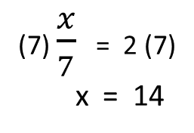
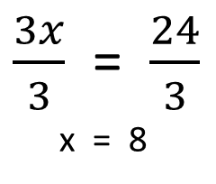
Solving Equations
(7) $\frac{x}{7}$ = 2 (7)
x = 14
Opposite of dividing
multiplying
Addition Equations
x + 4 = 7
$\frac{3x}{3}$ = $\frac{24}{3}$
x = 8
Opposite of multiplying
dividing
Subtraction
Equations
x - 4 = 7
x - 4 = 7
+ 4 + 4
x - 0 = 11
Opposite of subtracting
adding
Multiplication
Equations
3x = 24
x + 4 = 7
- 4 - 4
x + 0 = 3
Opposite of adding
subtracting
Division Equations
$\frac{x}{7}$ = 7

