Slide 1
of a Number
of a Number
Percent
Percent

Slide 2
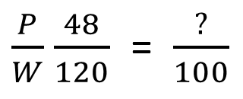
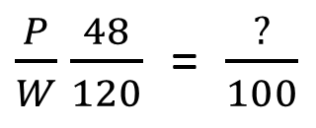
The “of” in 40% of 120 means to ____________.
The “of” in 40% of 120 means to ____________.
-Change to a decimal and multiply
-Change to a decimal and multiply
4 0 %
4 0 %
120 • .40 = 48
120 • .40 = 48
Part
Percent (%)
Part
Percent (%)
Whole
100
Whole
100
Or…
Or…
Cross multiply
48 is what percent of 120.
Cross multiply
48 is what percent of 120.
$\frac{P}{W}$ $\frac{48}{120}$ = $\frac{?}{100}$
$$48 •100=4800$$
$\frac{P}{W}$ $\frac{48}{120}$ = $\frac{?}{100}$
$$48 •100=4800$$
$$4800 ÷120=40\%$$
$$4800 ÷120=40\%$$

