Slide 1
and Integers
Different
Sign
Same
Sign

Slide 2
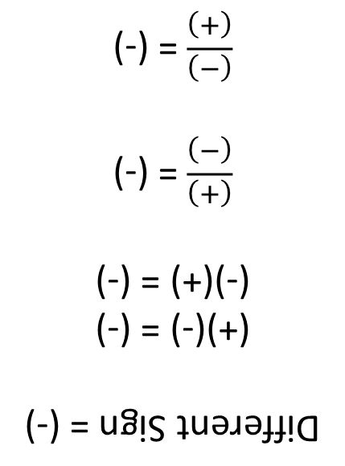
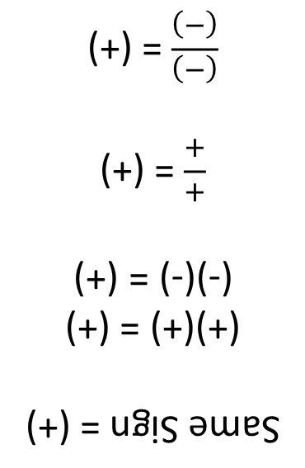
Dividing
Ex. 1:
Ex. 2:
Dividing
Ex. 1:
Ex. 2:
+
_
_
Multiplying
Ex. 1:
Ex. 2:
Multiplying
Ex. 1:
Ex. 2:
Same Sign = (+)
(+)(+) = (+)
(-)(-) = (+)
$\frac{+}{+}$ = (+)
$\frac{(−)}{(−)}$ = (+)
Different Sign = (-)
(+)(-) = (-)
(-)(+) = (-)
$\frac{(+)}{(−)}$ = (-)
$\frac{(−)}{(+)}$ = (-)

