Slide 1


F → D
D → F
P → F
$$\frac{2}{5}$$
0.4
40%
-Divide numerator by the denominator
“top dog in the house”
-Say the decimal
-Write fraction the way it sounds
-% means out of 100
-Place number over 100
-Simplify
0.4 → 4 tenths → $\frac{4}{10}$
$$\frac{2}{5}$$
$\frac{40}{100}$ remove zeros
THEN SIMPLIFY
F → P
D → P
P → D
$$\frac{2}{5}$$
0.4
40%
-Set up as a proportion
-Put % symbol
-Move decimal to the right 2 places
-Put % symbol
-Move decimal to the left 2 places
-Remove % symbol
X 20
0.40 =
40. % =
2
5 | 100
X 20
40%
% means OUT OF 100
-Multiply by 100
-Divide by 100

Slide 2
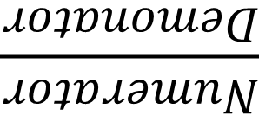
Fraction
Decimal
Percent
1.234
ONE WHOLE
100%
$$\frac{Numerator}{Demonator}$$
ONE S
TENTHS
HUNDREDTHS
THOUSANDTHS

